Slide 1

Mini Project
Based on
Android Based Location Service
Submitted by: Submitted to:
Name:- Chiranjib Ghosh Mr. Dilip Kumar Gangwar (CC-IV sem-H)
Sec:-H Guided by: University Roll:-1918308 Mr. Avnish Panwar
Btech(Cse)-IV-Sem

Slide 2
INTRODUCTION
This project based on In Android Service. Android always has it’s own Framework for location updates. Android location APIs make it easy for you to build location-aware applications, without needing to focus on the details of the underlying location technology. In this project it’s very easy to get latest location updates through framework
For this we need to java code for implementation. Because all kind of location framework is available on java location framework. This language is very high level language and we used various inbuild method as well as interface for implementing this project. All method and class or interface already in android studio. So that it is easy to use the framework and implement the project carefully.

Slide 3
IMPLEMENTS THE PROJECT WITH SNAPSHOT
Step Wise Implementation:
First we need to start Android Studio. After Opening it we are used to create a simple UI with Button and some Images.
After creating UI we go for activity platform for coding in button area. In UI we just create Linear Layout.
Knowledge about Java programming Language.
In Coding we used location framework which already in android studio.
Various type of method and class used.
Then we start inbuild Android Virtual Device which’s features very low. Because we want to run my app in low quality device.
Then we run app and clicking the button we get the longitude and latitude of my current location which is in required to allow the location service of the device.
Here I do not use any kind of intents for pass.
Next few ppt I show my snapshot or running process the project.

Slide 4
About Java Programming
JAVA was developed by James Gosling at Sun Microsystems Inc in the year 1991, later acquired by Oracle Corporation. It is a simple programming language. Java makes writing, compiling, and debugging programming easy. It helps to create reusable code and modular programs.
Java is a class-based, object-oriented programming language and is designed to have as few implementation dependencies as possible. A general-purpose programming language made for developers to write once run anywhere that is compiled Java code can run on all platforms that support Java. Java applications are compiled to byte code that can run on any Java Virtual Machine. The syntax of Java is similar to c/c++.
Linear Layout:-
The linear layout is the most basic layout and it arranges its elements sequentially either horizontally or vertically. To arrange controls within a linear layout. It needs Orientation. It is android studio layout.

Slide 5
Android Studio
Android Manifest:-The manifest file describes essential information about your app to the Android build tools, the Android operating system, and Google Play.
This manifest.xml is read by the android system during installation of the application.
What is AVD or EMULATOR:-The android tooling contains an android device emulator. This emulator can be used run an Android virtual device. These AVD allows you to test your application on selected android version.
What is UI:-User Interface(UI) Design focus on anticipating what user might need to do and ensuring that the interface has elements that are easy to access. Understand and use to facilitate these actions.

Slide 6
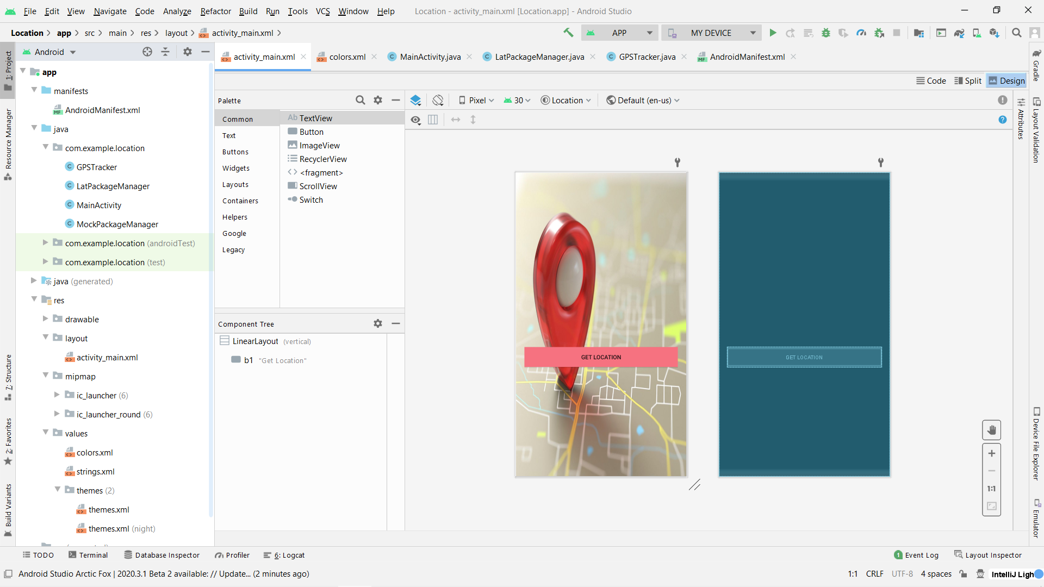
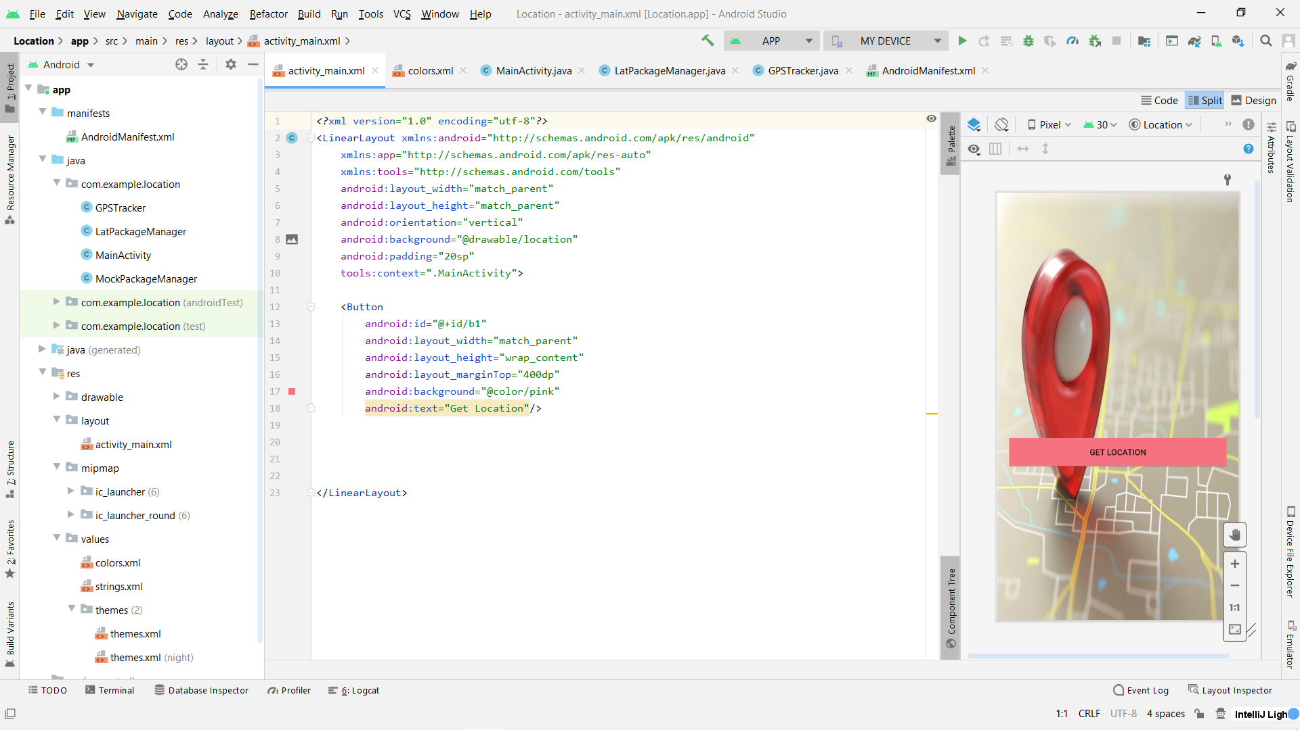
Snapshot Of UI:- In UI we used a images from google of location icon and one button Namely Get Location from we get the longitude and latitude.
Design With code in Split version

Slide 7
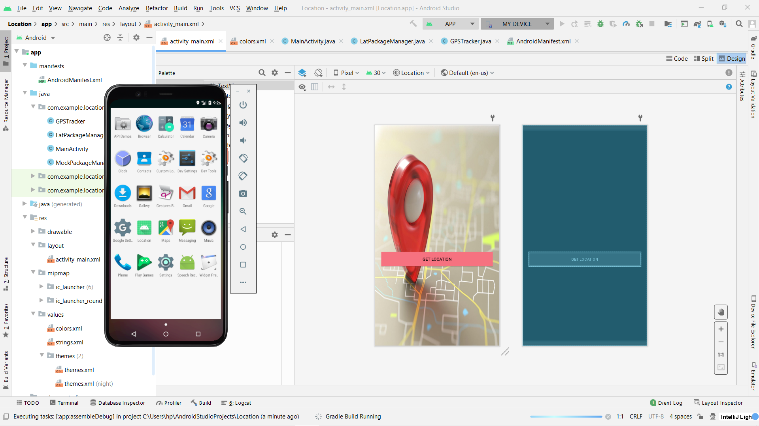
Android Virtual Device:- We create inbuild virtual device for run app.

Slide 8
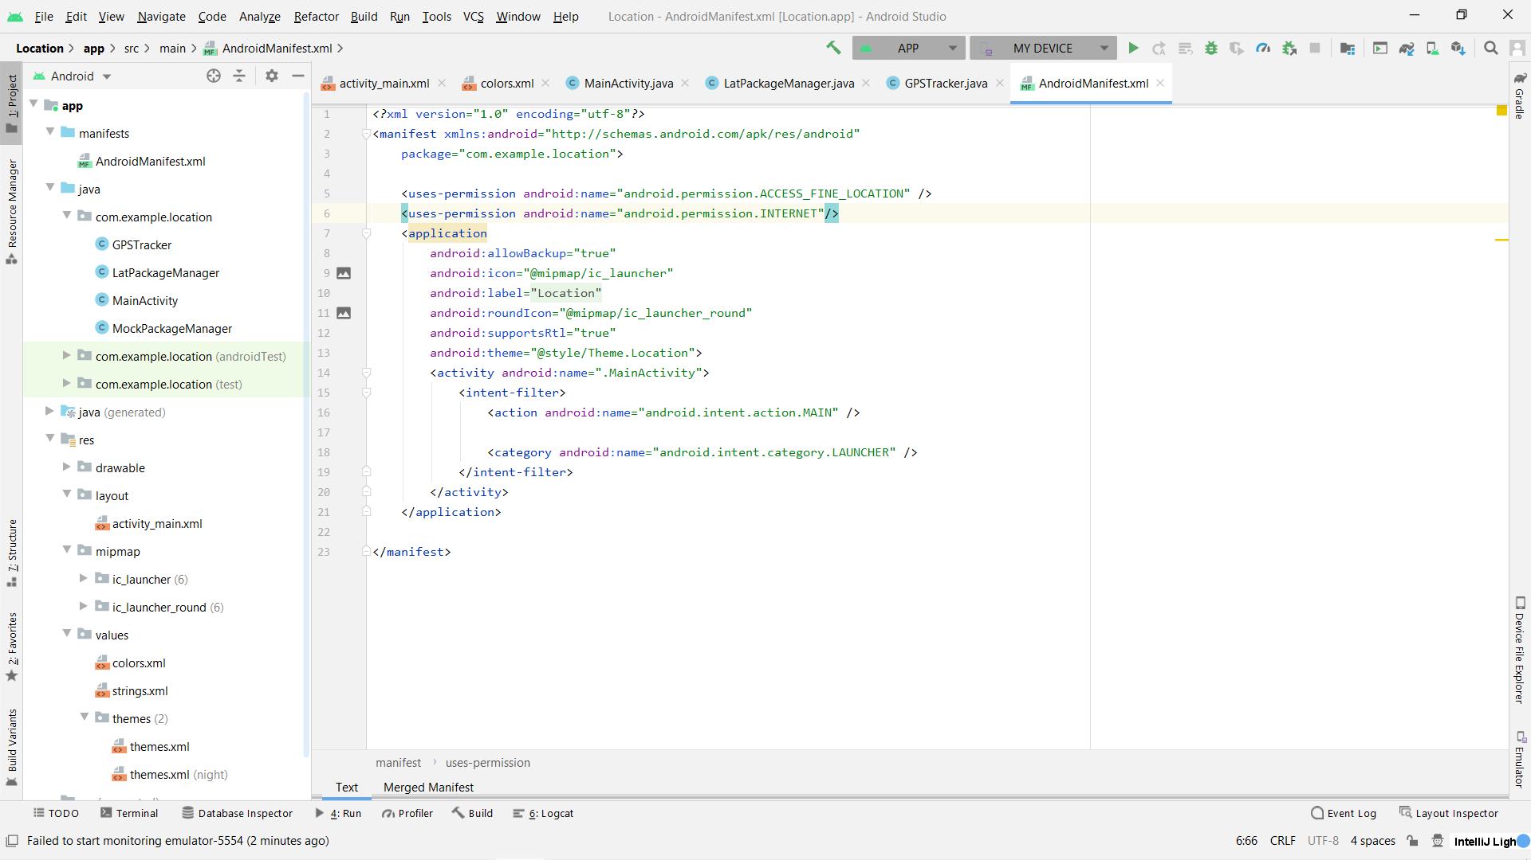
Manifest File:- Snapshot of manifest file in android studio.

Slide 9
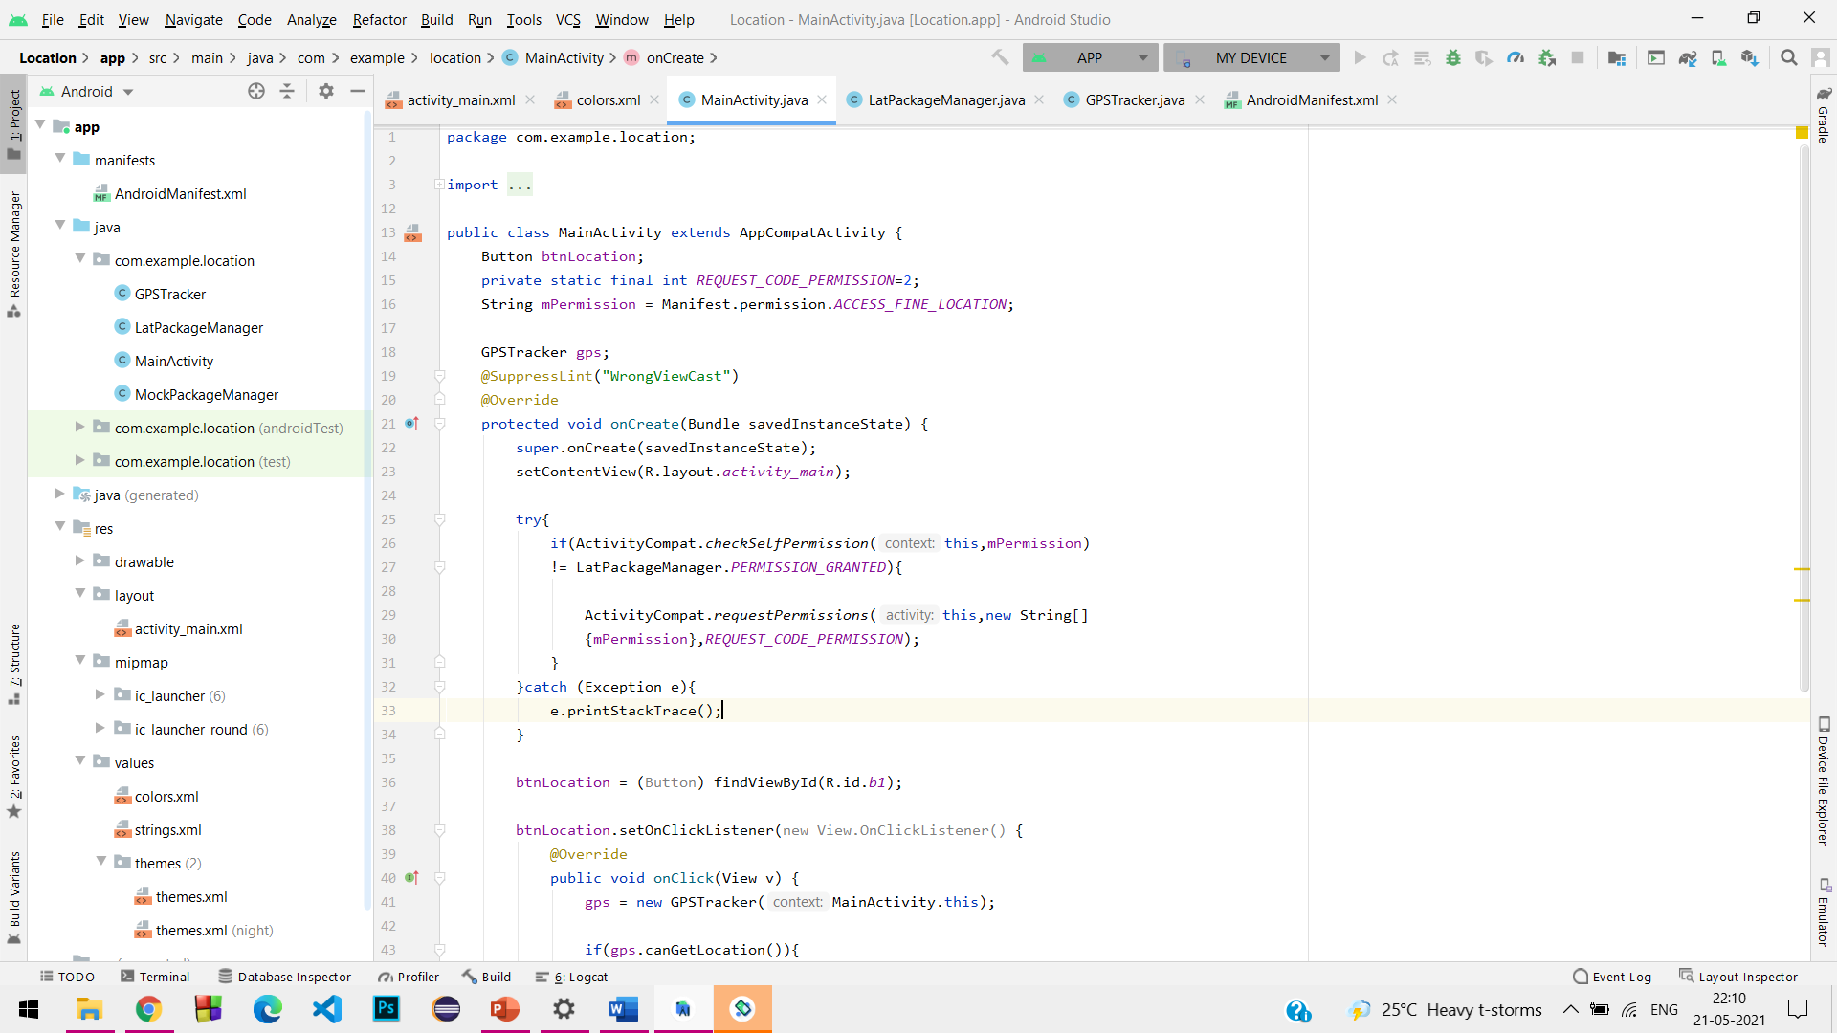
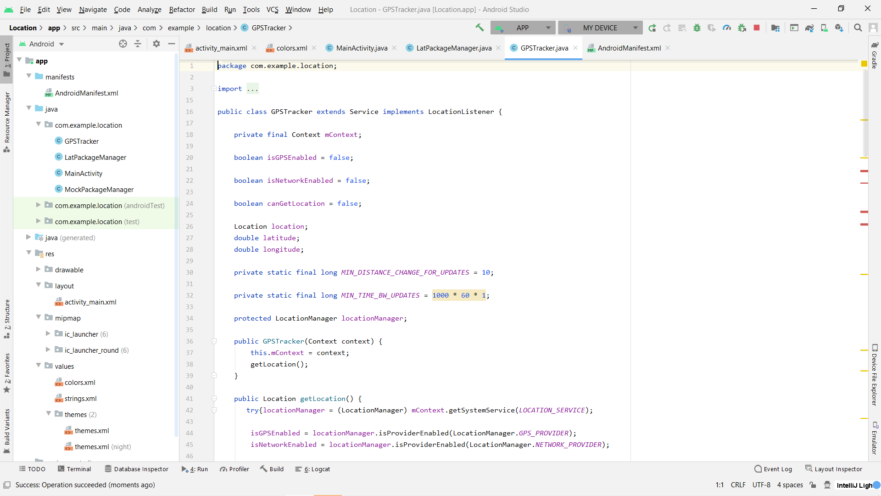
MainActivity and GpsTracker class which implement in Main activity file
MainActivity
GpsTracker

Slide 10
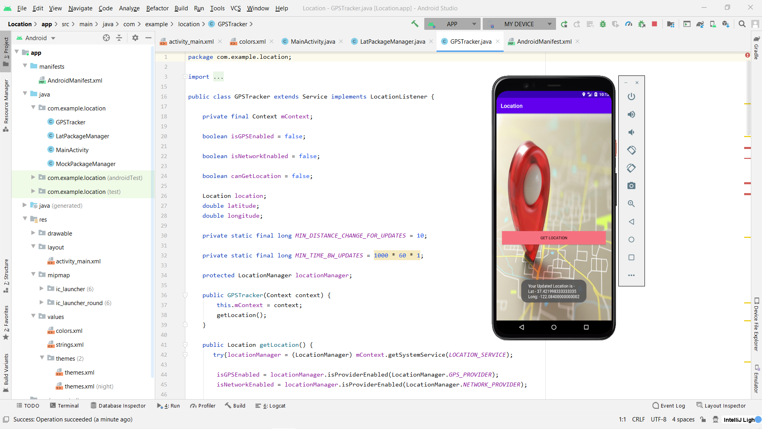
Running Process and getting Output in AVD After Clicking The GET LOCATION BUTTON

Slide 11
THANK YOU

